Slide 1


데이터 관리론
Data Engineering with Apache Airflow

Slide 2
Data Engineering with Apache Airflow

Slide 3
git & git hub
Git is the tool, GitHub is the service for projects that use Git.
Git is a revision control system, a tool to manage your source code history.
GitHub is a hosting service for Git repositories.
If all you want is version control - local git is just fine for that.
Remote repositories(git hub) are for backup and collaboration with your teams

Slide 4
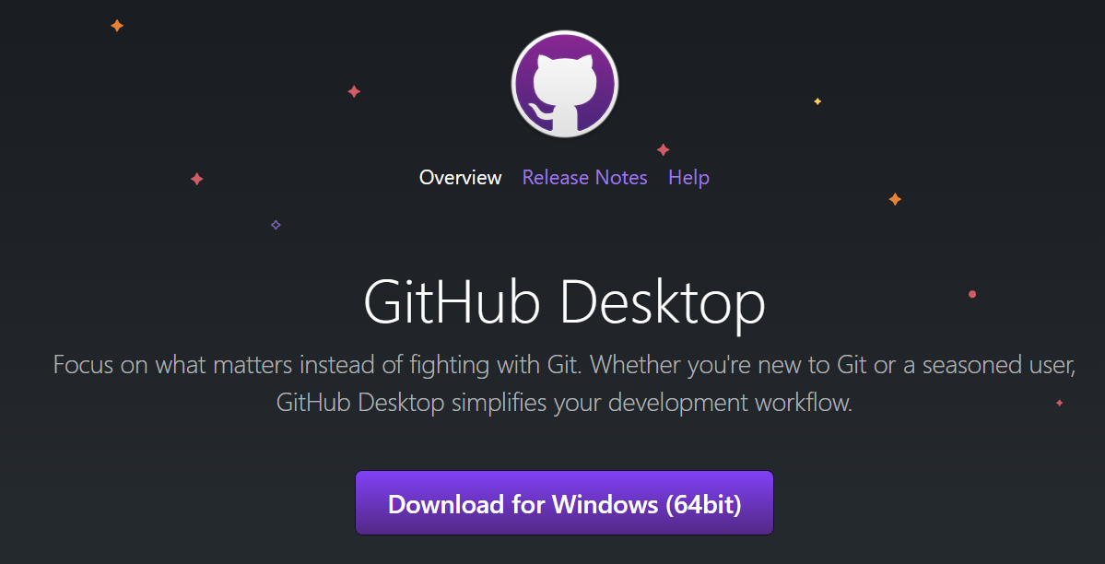
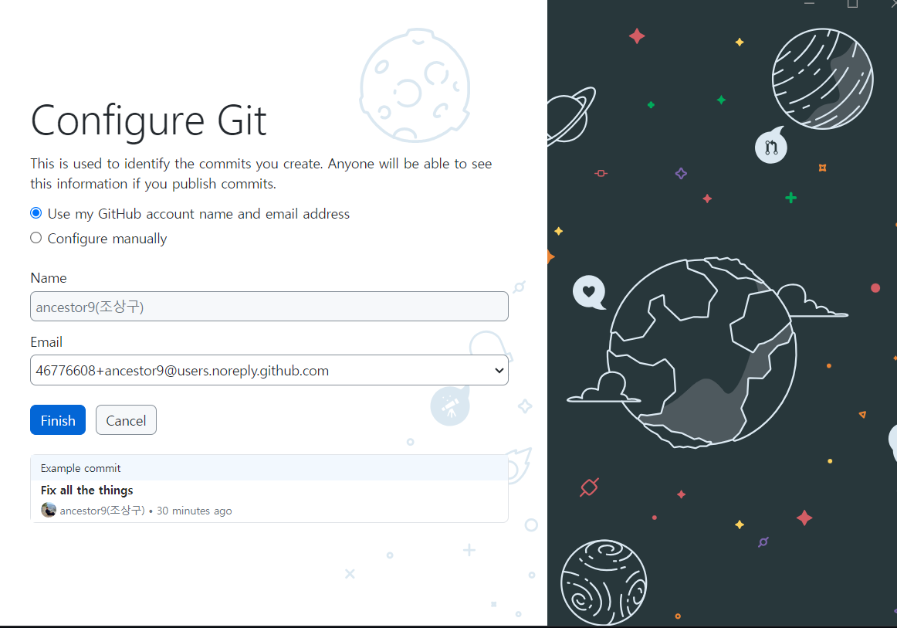
GitHub Desktop
Download GitHub Desktop (GUI version)
https://desktop.github.com/

Slide 5
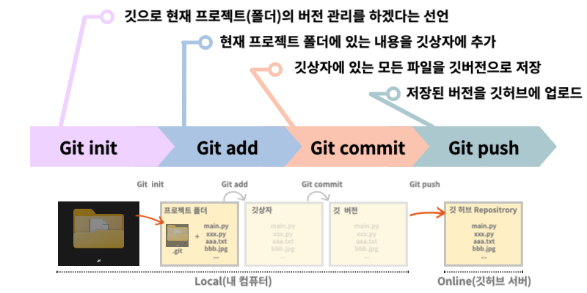
git 작동 순서
local host의 directory(class)를 github에 upload하는 명령어와 순서
https://aipoque.com/git-%EB%8F%99%EC%9E%91-%EC%9B%90%EB%A6%AC/

Slide 6
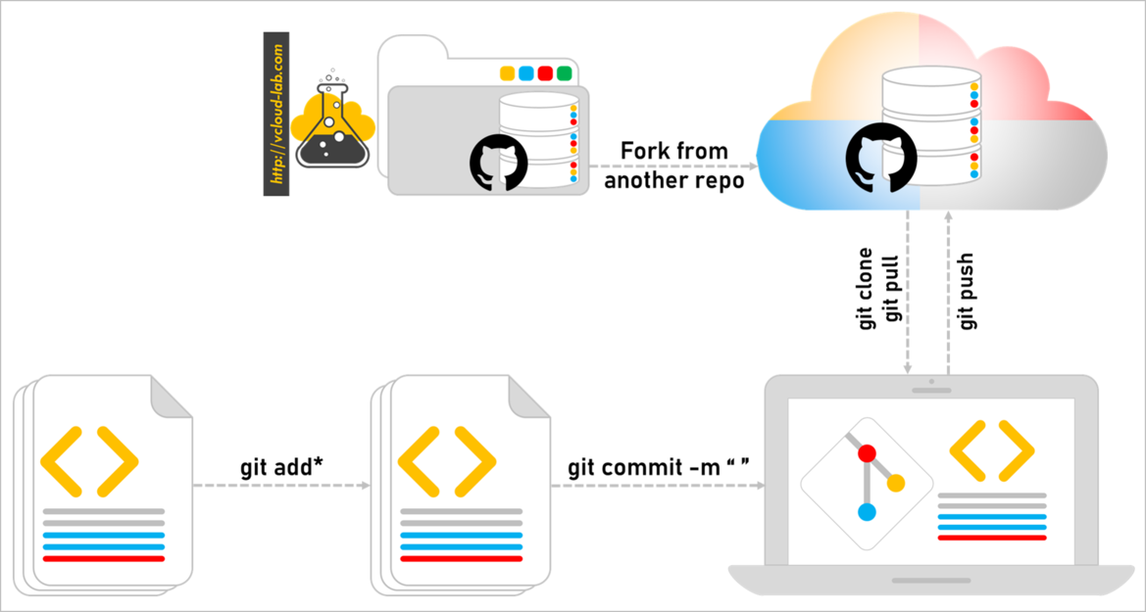
git 작동 순서
local host의 directory(class)를 github에 upload하는 명령어와 순서
http://vcloud-lab.com/entries/devops/Step-by-Step-guide-to-push-your-first-project-to-github-com

Slide 7

실습하기
version management

Slide 8
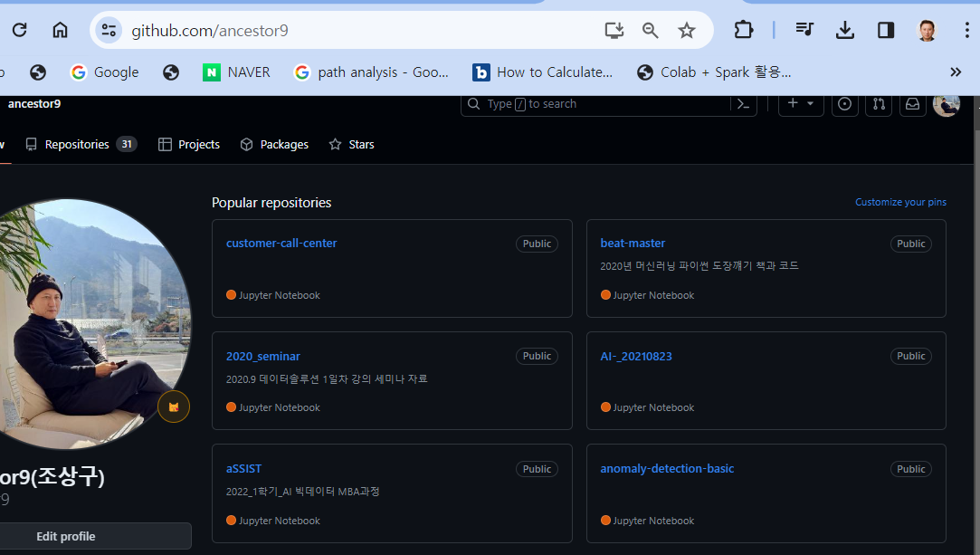
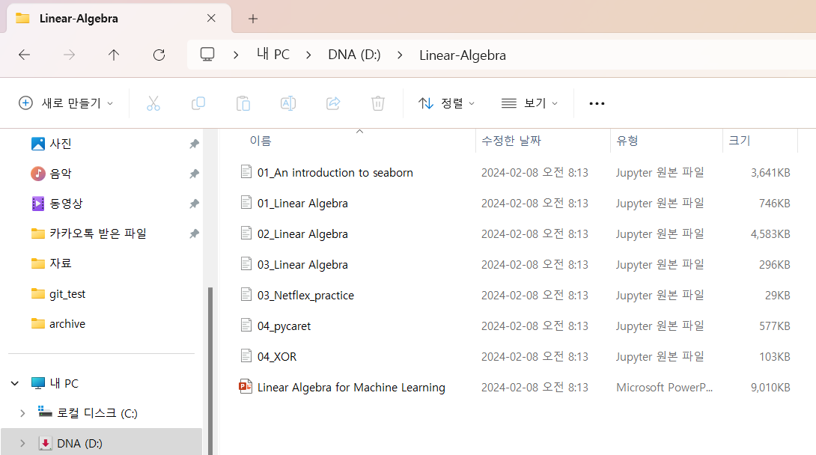
실습하기
local host의 directory(class)를 github에 upload하려면

Slide 9
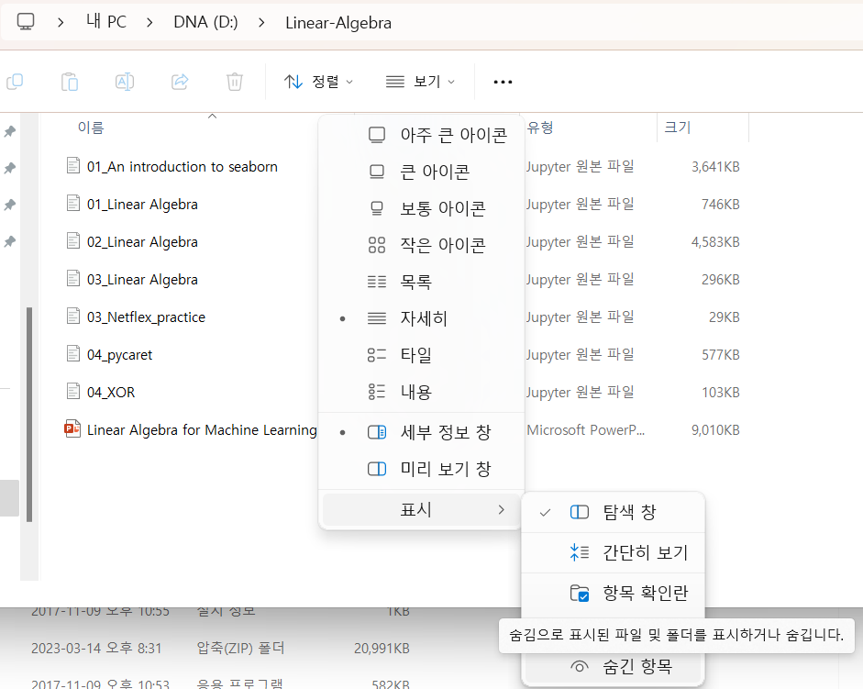
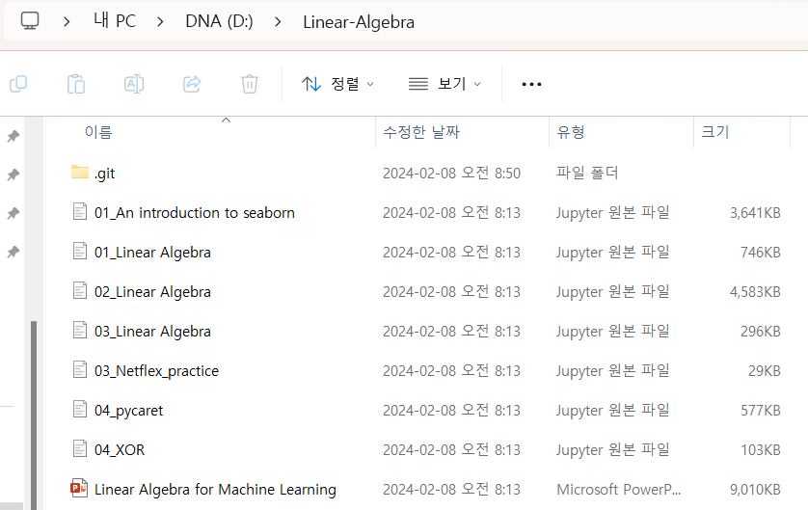
실습하기
PS D:\Linear-Algebra> git init
Initialized empty Git repository in D:/Linear-Algebra/.git/
PS D:\Linear-Algebra> git status
fatal: detected dubious ownership in repository at 'D:/Linear-Algebra'
'D:/Linear-Algebra' is on a file system that does not record ownership
To add an exception for this directory, call:
git config --global --add safe.directory D:/Linear-Algebra
PS D:\Linear-Algebra> git config --global --add safe.directory D:/Linear-Algebra
PS D:\Linear-Algebra> git status
On branch master
No commits yet
Untracked files:
(use "git add <file>..." to include in what will be committed)
01_An introduction to seaborn.ipynb
01_Linear Algebra.ipynb
02_Linear Algebra.ipynb
03_Linear Algebra.ipynb
03_Netflex_practice.ipynb
04_XOR.ipynb
04_pycaret.ipynb
Linear Algebra for Machine Learning.pptx
~$Linear Algebra for Machine Learning.pptx
nothing added to commit but untracked files present (use "git add" to track)

Slide 10
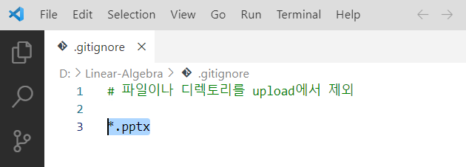
실습하기
PS D:\Linear-Algebra> code .gitignore
PS D:\Linear-Algebra> git status
On branch master
No commits yet
Untracked files:
(use "git add <file>..." to include in what will be committed)
.gitignore
01_An introduction to seaborn.ipynb
01_Linear Algebra.ipynb
02_Linear Algebra.ipynb
03_Linear Algebra.ipynb
03_Netflex_practice.ipynb
04_XOR.ipynb
04_pycaret.ipynb
nothing added to commit but untracked files present (use "git add" to track)
모든 파워포인트 파일은 upload에서 제외(.gitignore)

Slide 11
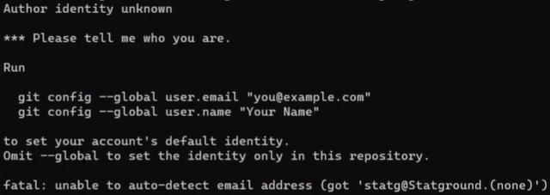
실습하기
.gitignore 파일만 commit & upload
PS D:\Linear-Algebra> git add .gitignore
PS D:\Linear-Algebra> git status
On branch master
No commits yet
Changes to be committed:
(use "git rm --cached <file>..." to unstage)
new file: .gitignore
Untracked files:
(use "git add <file>..." to include in what will be committed)
01_An introduction to seaborn.ipynb
01_Linear Algebra.ipynb
02_Linear Algebra.ipynb
03_Linear Algebra.ipynb
03_Netflex_practice.ipynb
04_XOR.ipynb
PS D:\Linear-Algebra> git commit -m "최초 .gitignore 파일 생성"
[master (root-commit) 5c27859] 최조초 .gitignore 파일 생성
1 file changed, 3 insertions(+)
create mode 100644 .gitignore

Slide 12
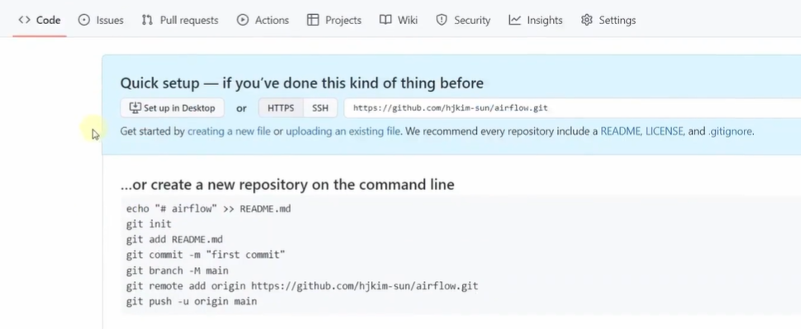
실습하기
PS D:\Linear-Algebra> git status
PS D:\Linear-Algebra> git log
commit 5c2785958c57113cbf323b4f7fb830a8a41d9532 (HEAD -> master)
Author: ancestor9 <ancestorcho30@gmail.com>
Date: Thu Feb 8 10:16:14 2024 +0900
최초 .gitignore 파일 생성

Slide 13
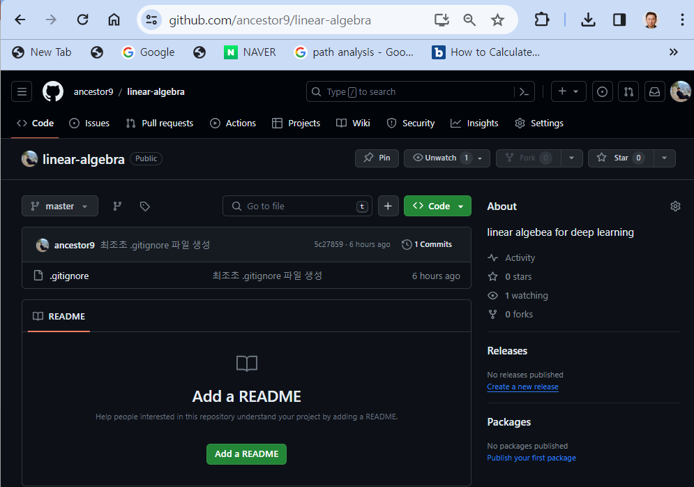
실습하기
PS D:\Linear-Algebra> git remote add origin https://github.com/ancestor9/linear-algebra.git
error: remote origin already exists.
PS D:\Linear-Algebra> git push -u origin master
Enumerating objects: 3, done.
Counting objects: 100% (3/3), done.
Delta compression using up to 8 threads
Compressing objects: 100% (2/2), done.
Writing objects: 100% (3/3), 307 bytes | 307.00 KiB/s, done.
Total 3 (delta 0), reused 0 (delta 0), pack-reused 0
To https://github.com/ancestor9/linear-algebra.git
* [new branch] master -> master
branch 'master' set up to track 'origin/master'.

Slide 14
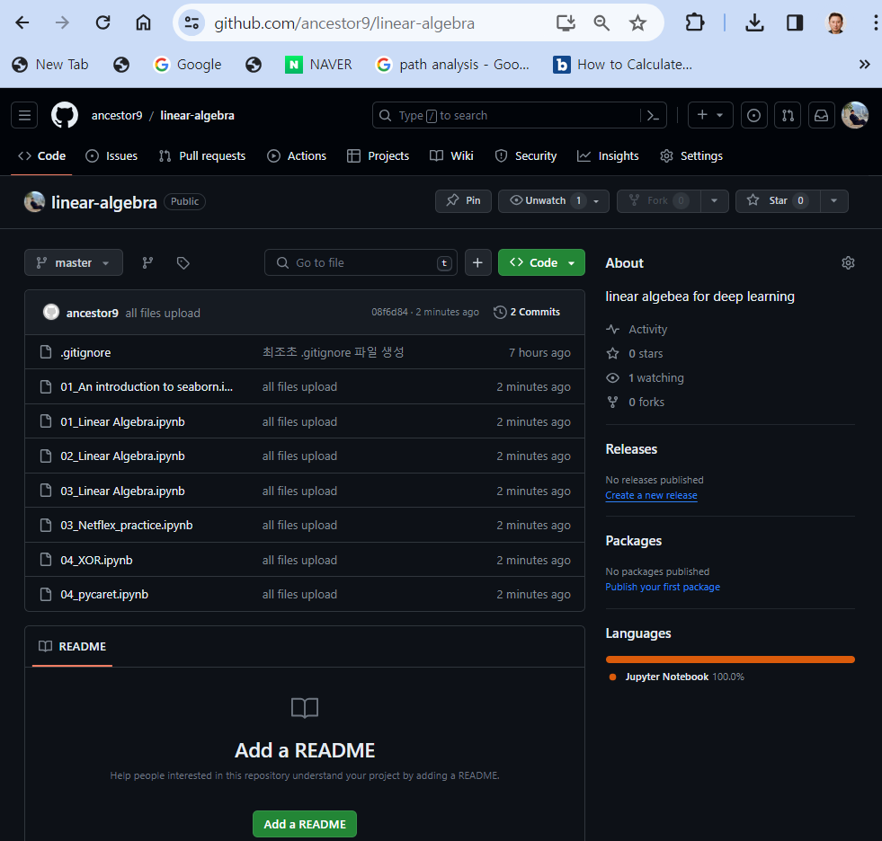
실습하기
모든 파일(pptx파일만 제외) commit & upload
PS D:\Linear-Algebra> git add -A
PS D:\Linear-Algebra> git commit -m "all files upload"
[master 08f6d84] all files upload
7 files changed, 7 insertions(+)
create mode 100644 01_An introduction to seaborn.ipynb
create mode 100644 01_Linear Algebra.ipynb
create mode 100644 02_Linear Algebra.ipynb
create mode 100644 03_Linear Algebra.ipynb
create mode 100644 03_Netflex_practice.ipynb
create mode 100644 04_XOR.ipynb
create mode 100644 04_pycaret.ipynb
PS D:\Linear-Algebra> git push origin master
Enumerating objects: 10, done.
Counting objects: 100% (10/10), done.
Delta compression using up to 8 threads
Compressing objects: 100% (9/9), done.
Writing objects: 100% (9/9), 6.54 MiB | 3.86 MiB/s, done.
Total 9 (delta 1), reused 0 (delta 0), pack-reused 0
remote: Resolving deltas: 100% (1/1), done.
To https://github.com/ancestor9/linear-algebra.git
5c27859..08f6d84 master -> master

Slide 15


과제제출
https://learning.edx.org/course/course-v1:HarvardX+CS50W+Web/block-v1:HarvardX+CS50W+Web+type@sequential+block@e1db1d5394cf476ba0c925010b94a5f4/block-v1:HarvardX+CS50W+Web+type@vertical+block@491cd816e2554378ac994cd14335c1c6
due date : 1 week
name.pdf

Slide 16
실습하기
version management

Slide 17
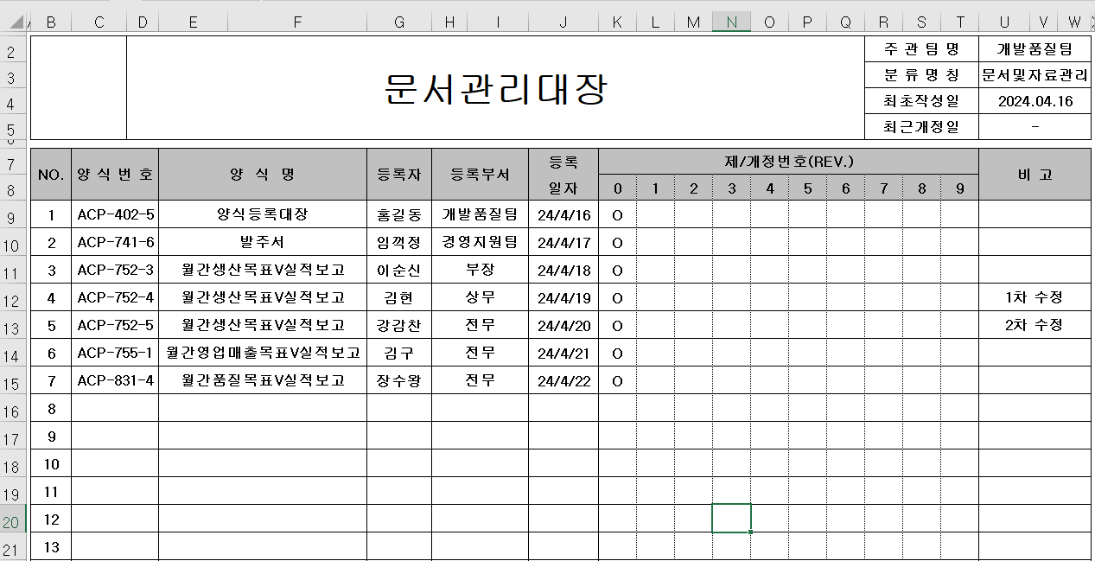
실습하기

Slide 18
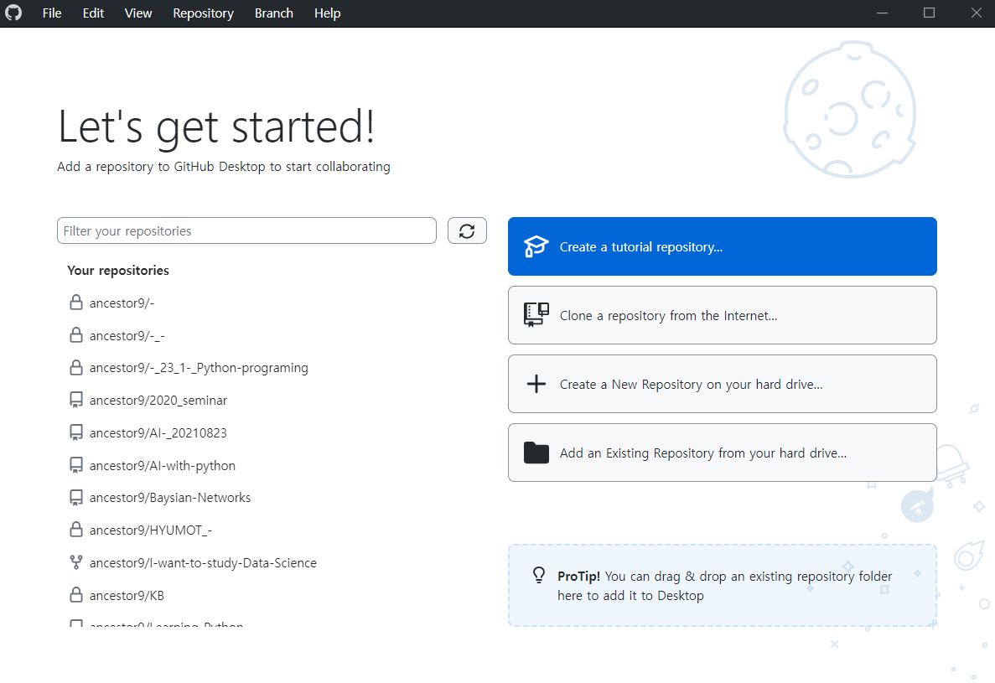
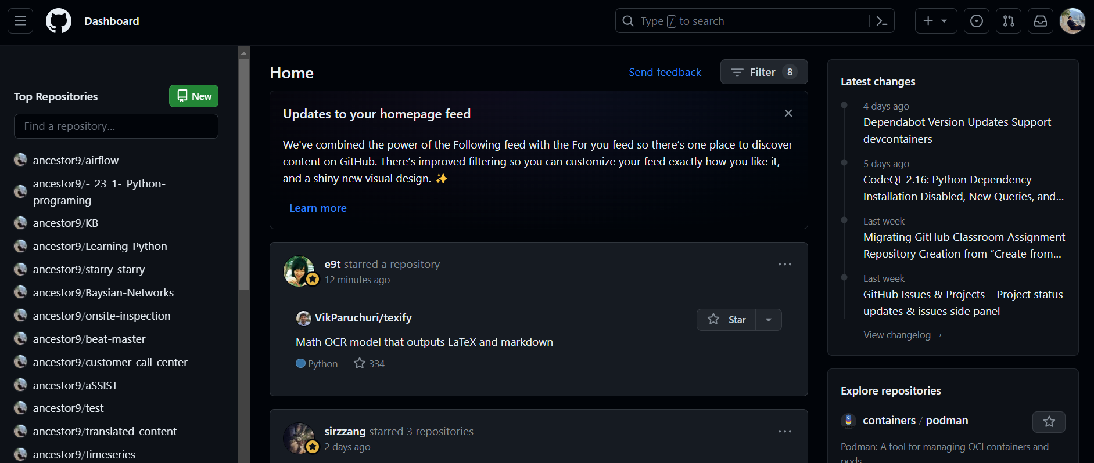
GitHub Desktop

Slide 19
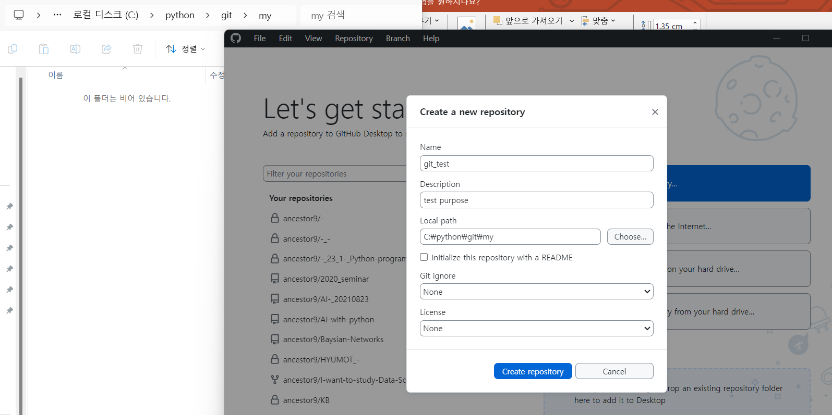
GitHub Desktop

Slide 20
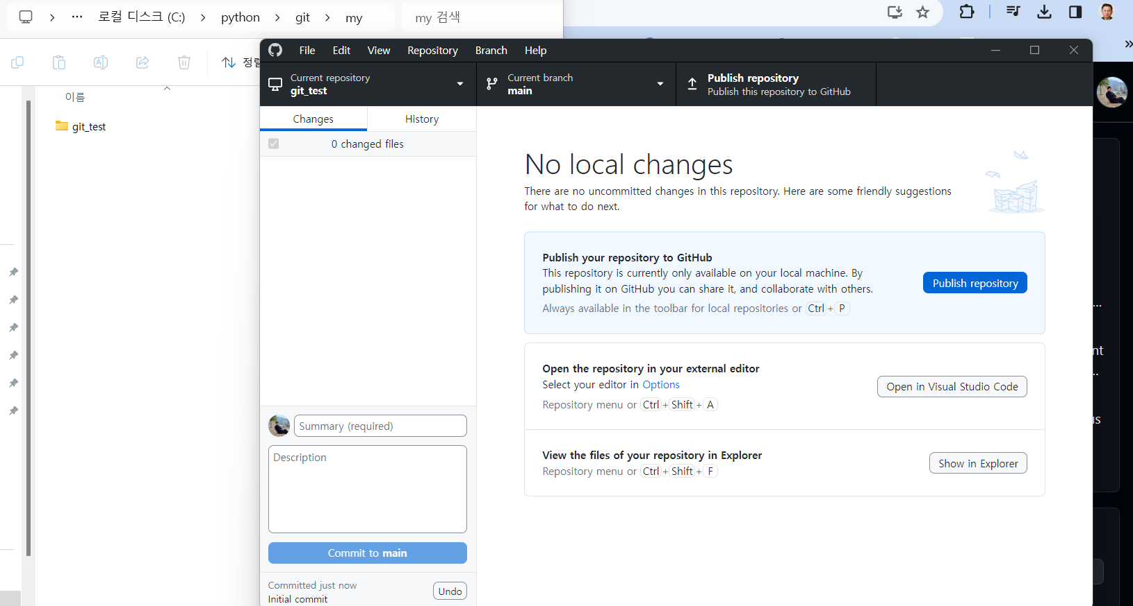
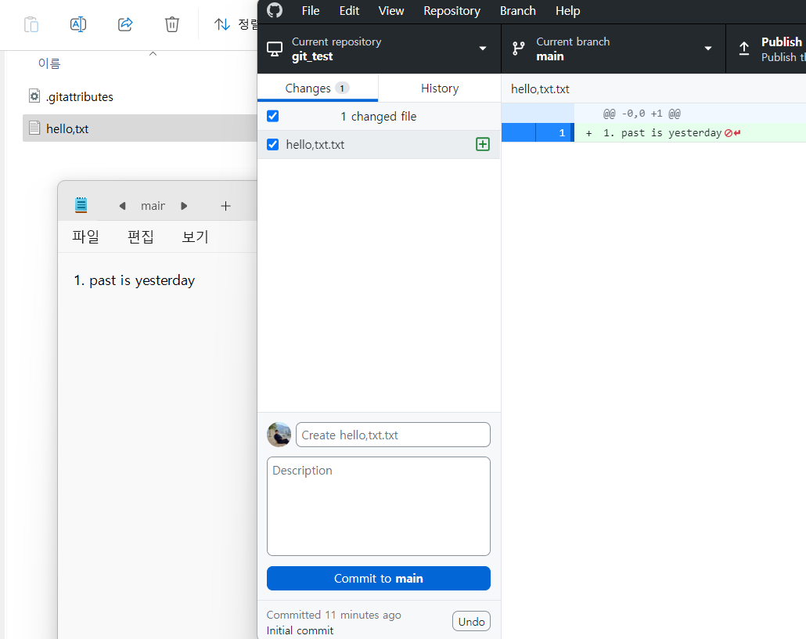
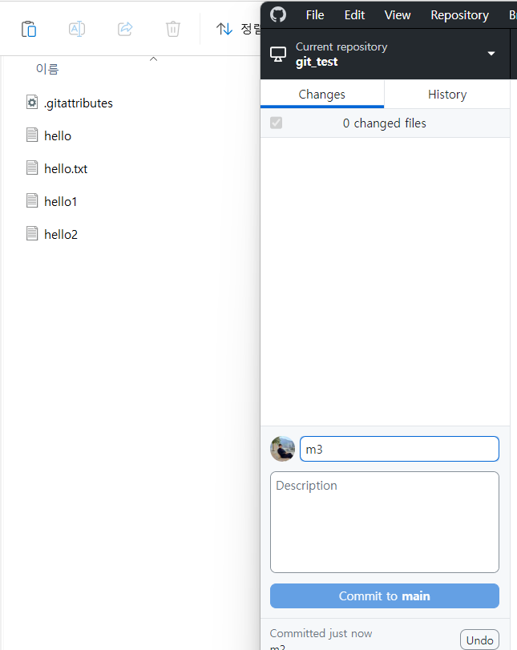
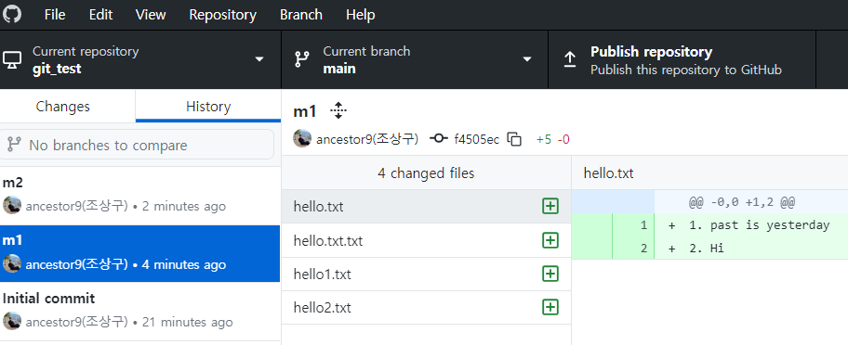
Code version configuration
생활코딩
https://www.youtube.com/watch?v=9fSEVG5D6vk&t=279s
https://opentutorials.org/course/3837/22435

Slide 21
GitHub Desktop

Slide 22
GitHub Desktop

Slide 23
GitHub Desktop

Slide 24
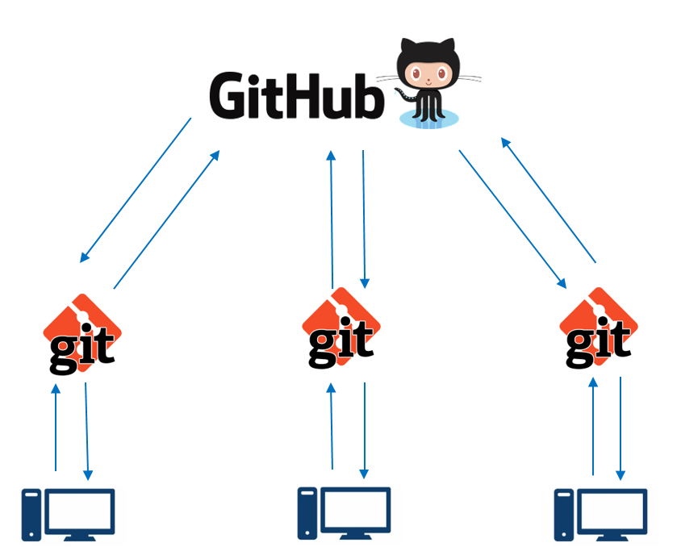
git & git hub
Distributed version control system
Remote Repository on GitHub
Push
Pull
Local clone of Repository
Commit
Update

Slide 25
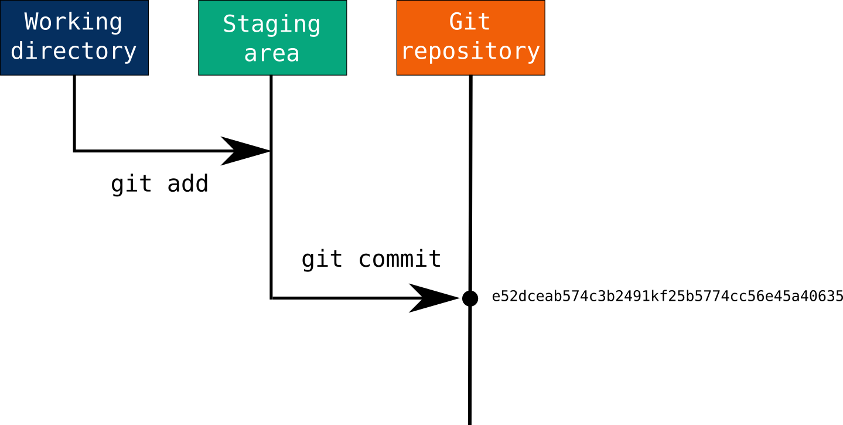
git & git hub
Local computer
# Initialize a new Git repository in your working directory
$ git init
# Add files to the staging area (you may need to create some files first)
$ git add .
# Commit the changes with a commit message
$ git commit -m "first commit“
# upload into remote repository
$ git push
# download from remote repository
$ git pull
git init
# short cut
git add . && git commit -m “@@@@" && git push

Slide 26
실습하기
airflow_01

Slide 27

실습하기
프랑스 파리(directory)에 놀러가서 디지털카메라 Camera git을 준비하고(git init) 피사체를 정하고(git add) 셔터를 눌러 필름 인화를 완료(git commit)하고 구글이나 네이버 사진 cloud 에 올리는 작업(git push)

Slide 28

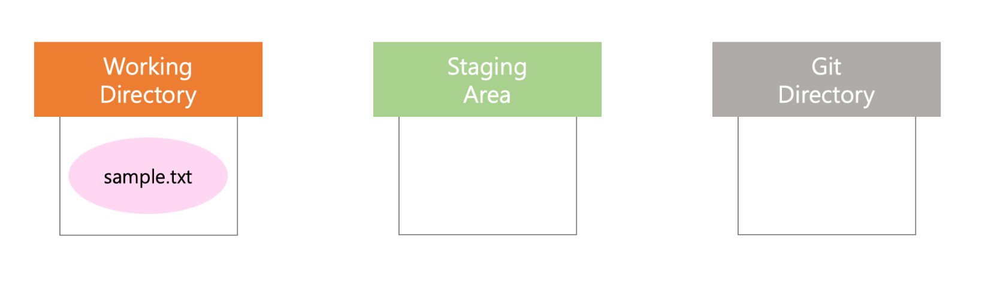
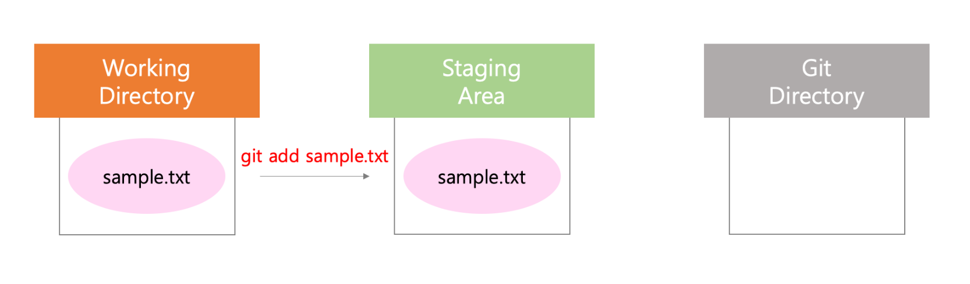
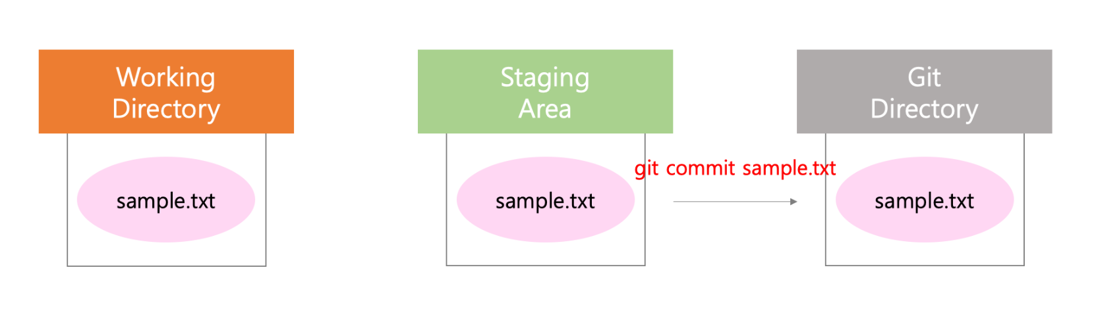
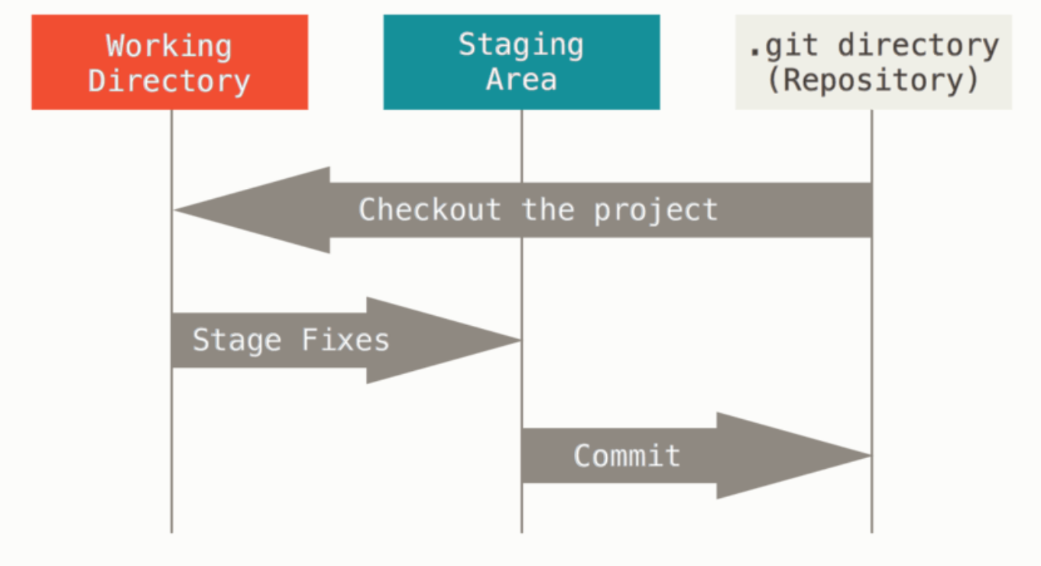
실습하기
https://seonkyukim.github.io/git-tutorial/git-install/

Slide 29
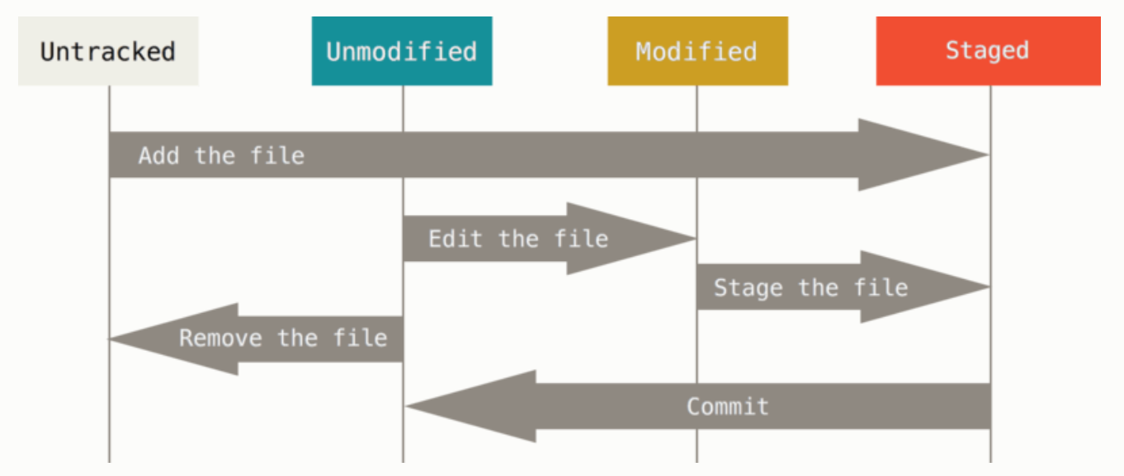
실습하기
https://seonkyukim.github.io/git-tutorial/git-install/

Slide 30
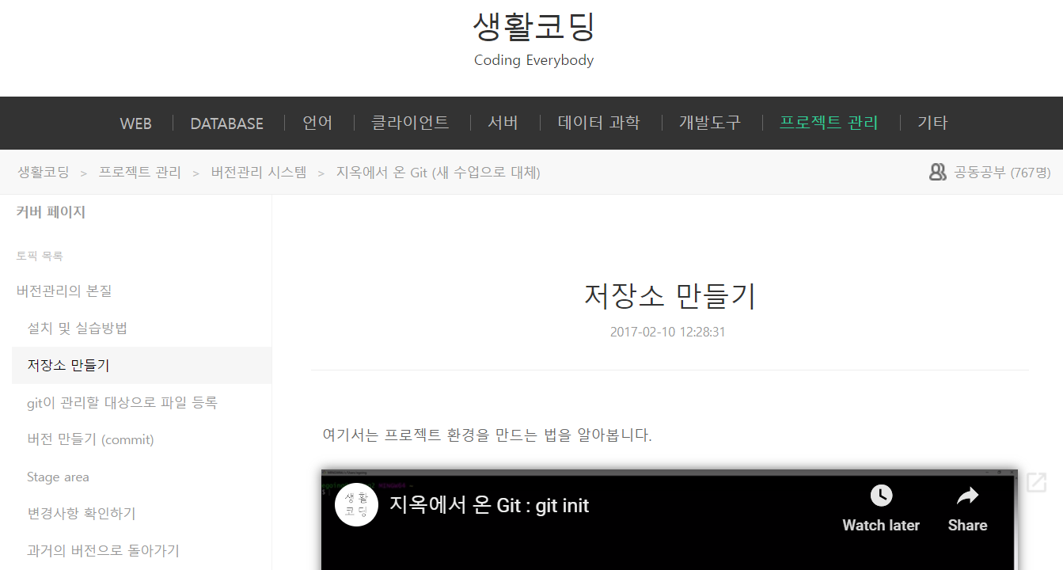
실습
https://opentutorials.org/course/2708/15170

Slide 31
과제제출
due date : 1 week
name.pdf

